Slide 1
A
B
b
d
d
c
a
a
X
2
3
I I
I I
I I
I I
I I
I I
I I
I I
I I
I I
I I
I I
I I
I I
I I
I I
I I
I I
437^{R}
892^{S}
Figure 1. The proportion of wasp embryo encapsulated by the F1 progeny obtained from crosses between resistant (DGRP-437) and susceptible (DGRP-892) lines. The recombinant lines larvae with different chromosome combinations were dissected after wasp infection. The number of larvae dissected for each line is stated above the error bars. The sample size were between 63 and 107.
Figure 2. The genetic mapping of regions of chromosome 2 which are associated with of encapsulation of wasp embryo. Fine-scale Quantitative Trait Loci Map of parasitoid resistance obtained from genotyped flies that encapsulated a wasp embryo and tested positive for wasp DNA. χ² statistic shows the expected Mendelian frequency deviation the marker allele frequency deviated from the n expectation of 0.5 for each marker. A 95% confidence interval was obtained on the location of the QTL.
Notes:
chi

Slide 2
A
B
42
96
90
36
40
50
49
54
26
15
892
17
437
Figure 2. Resistance of genotyped recombinant lines to parasitoid infection. (A) Homozygote lines obtained from meiotic recombination were genotyped to determine where the break point lies on chromosome two. Lines where recombination occurred between 3cM and 34cM were genotyped at positions 10cM, 10.7cM (Lectin 24-A), 12cM, 17cM and 27cM using flanking markers to confirm region of chromosome from resistant line DGRP-437 in red and susceptible line (DGRP-892 in blue. (B) Encapsulation response to L.boulardi g486 was determined in F1 progeny of female C3 flies crossed with REC lines which had undergone recombination between 3cM and 34cM. Lines which tested positive for Lectin 24A are in red and lines which do not have lectin are in blue. Each point shows 20 larvae dissected per vial for each line. The error bars show a 95% confidence interval

Slide 3
A
B
b
b
a,b
b
a,b
b,c
a
c
a,c
a
a
a
X
2
3
I I
I I
I I
I I
I I
I I
I I
I I
I I
I I
I I
I I
I I
I I
I I
I I
I I
I I
437
892
X
2
3
I I
I I
I I
I I
I I
I I
I I
I I
I I
I I
I I
I I
I I
I I
I I
I I
I I
I I
Figure 3. Circulating hemocytes present in homeostasis in Drosophila lines with different chromosome combinations. (A) The boxplot is the concentration of circulating plasmatocytes and (B) lamellocyte in the different chromosome combination lines without L.boulardi infection. The points on each box plot represents the mean concentration of hemocytes that were counted for each vial per line and vial contained hemolymph from 12-20.

Slide 4
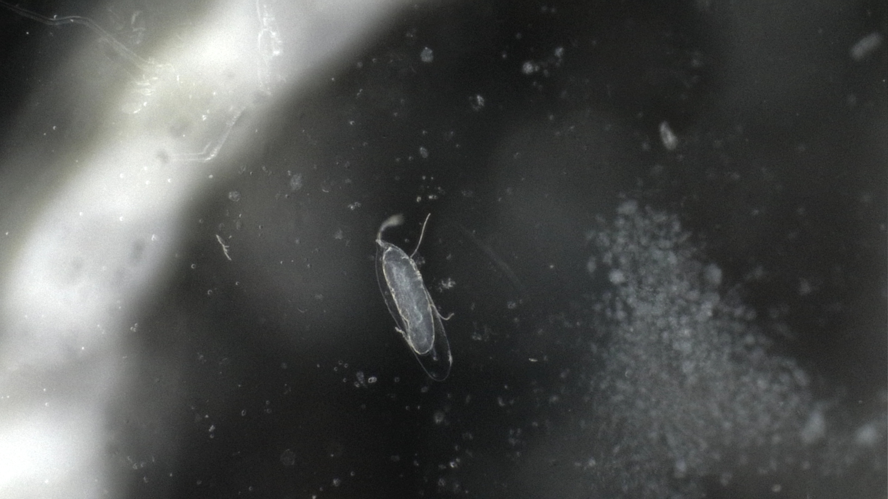
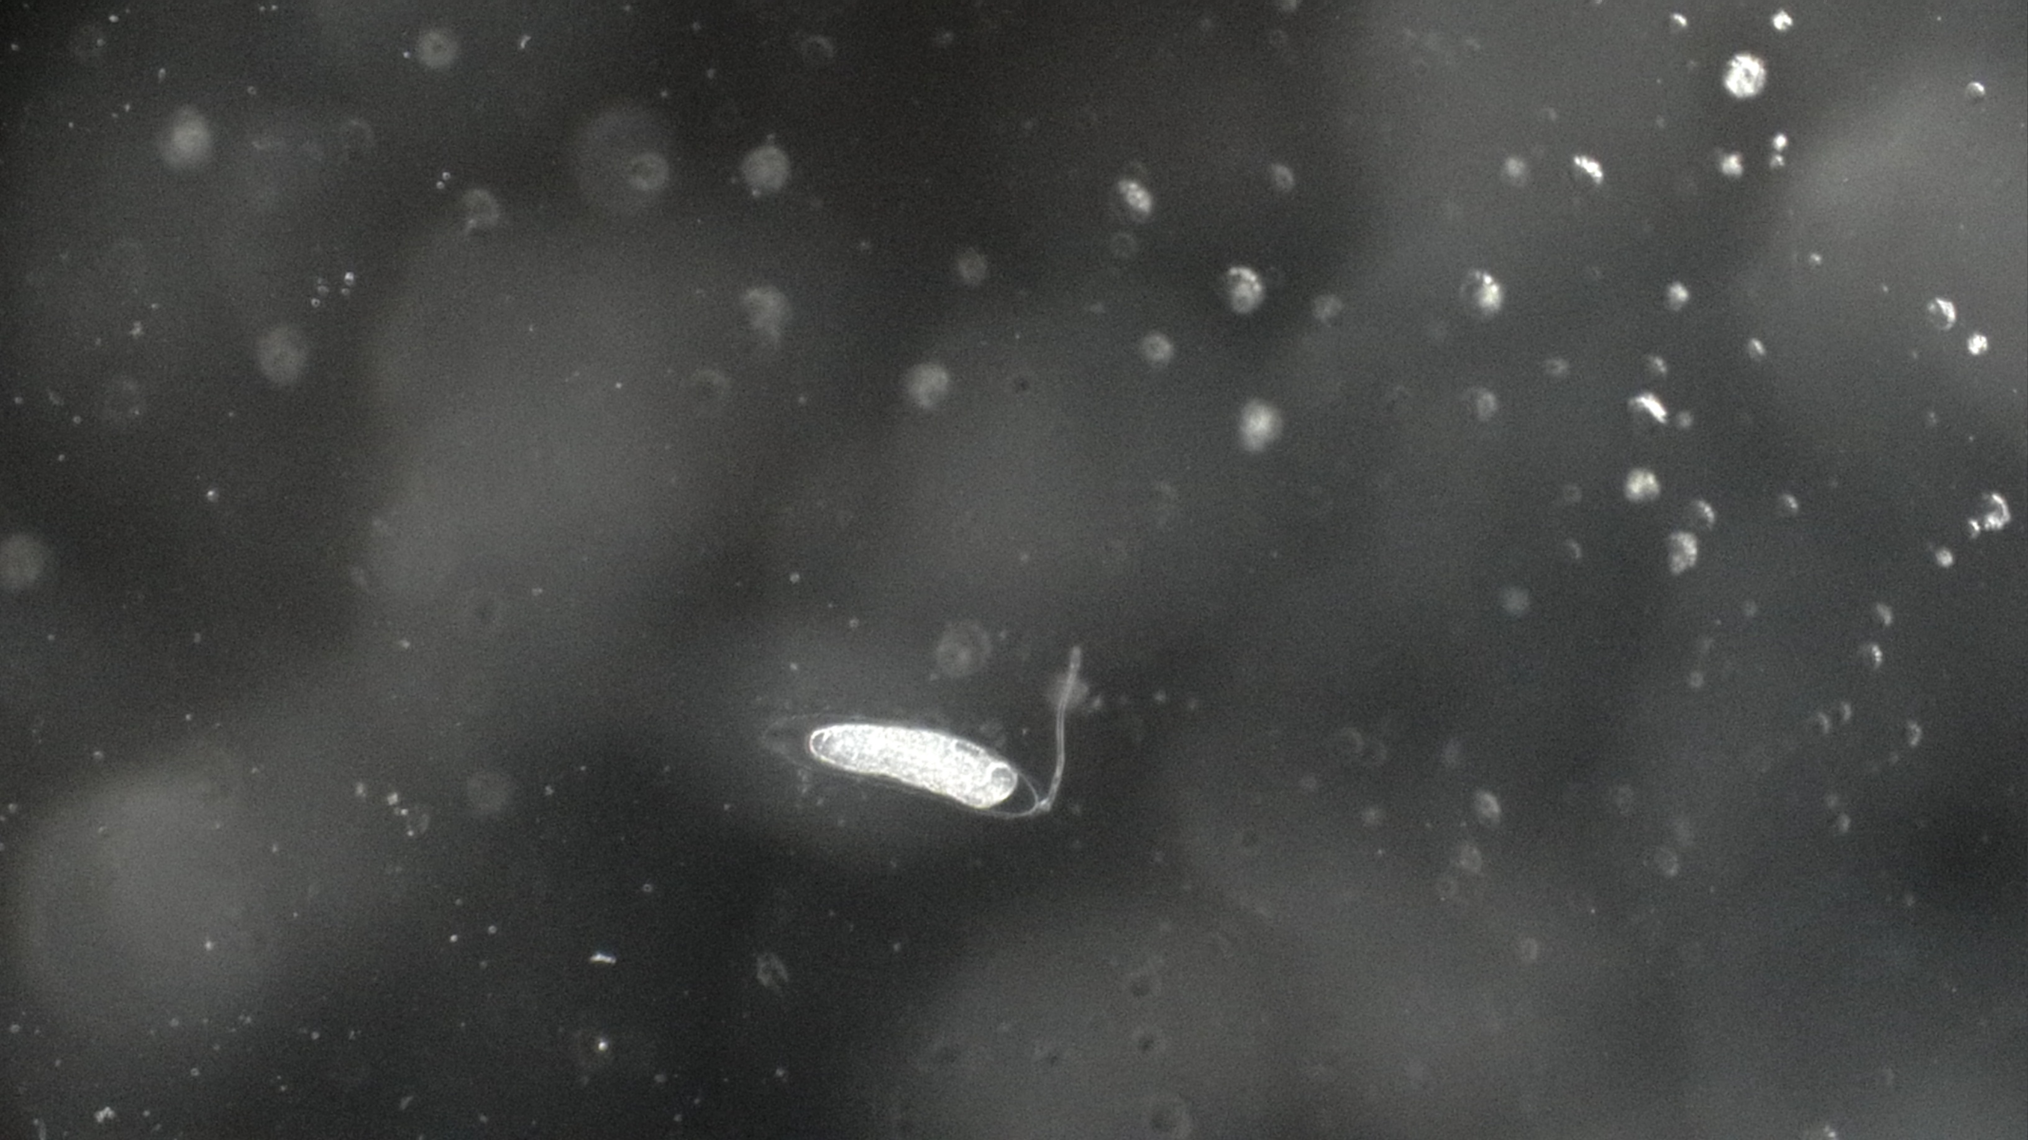
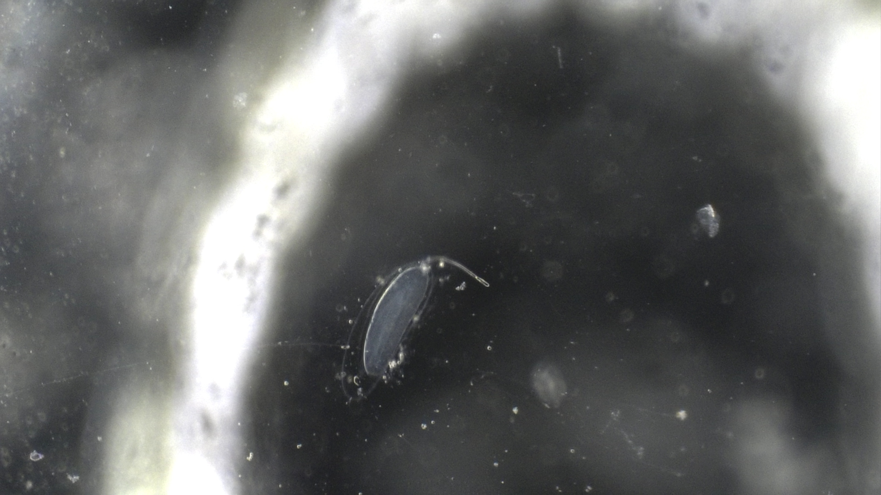
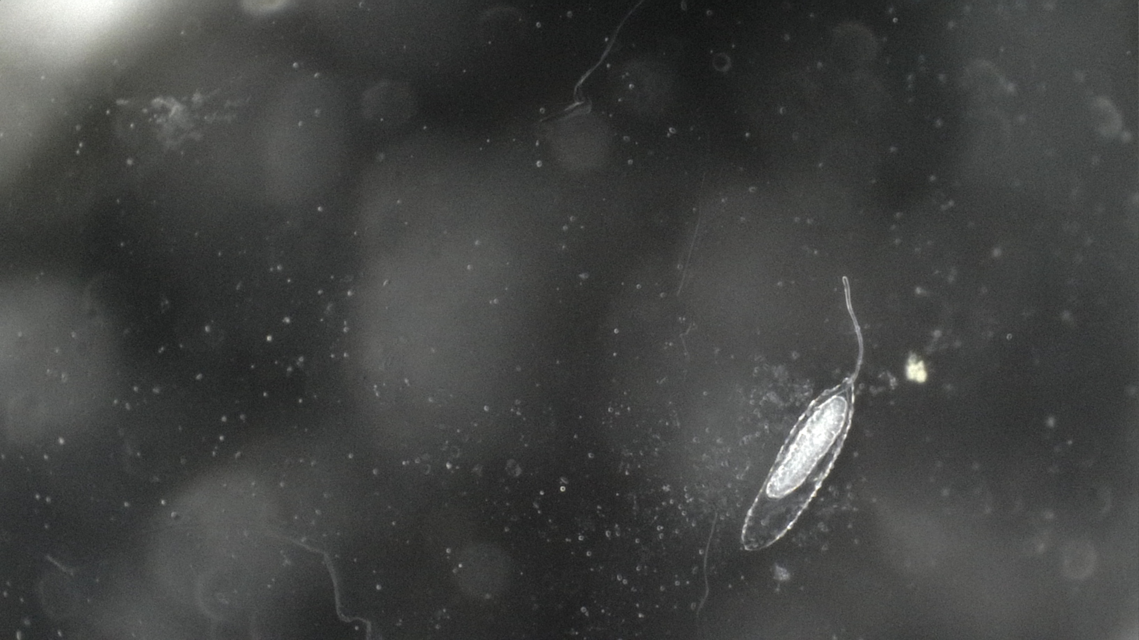
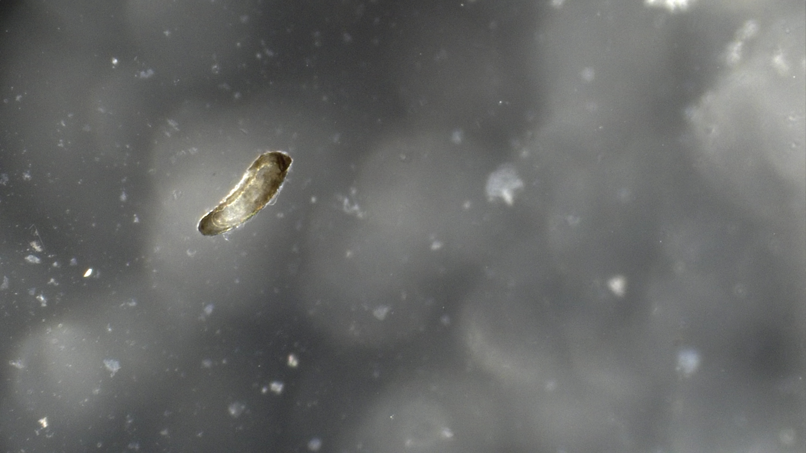
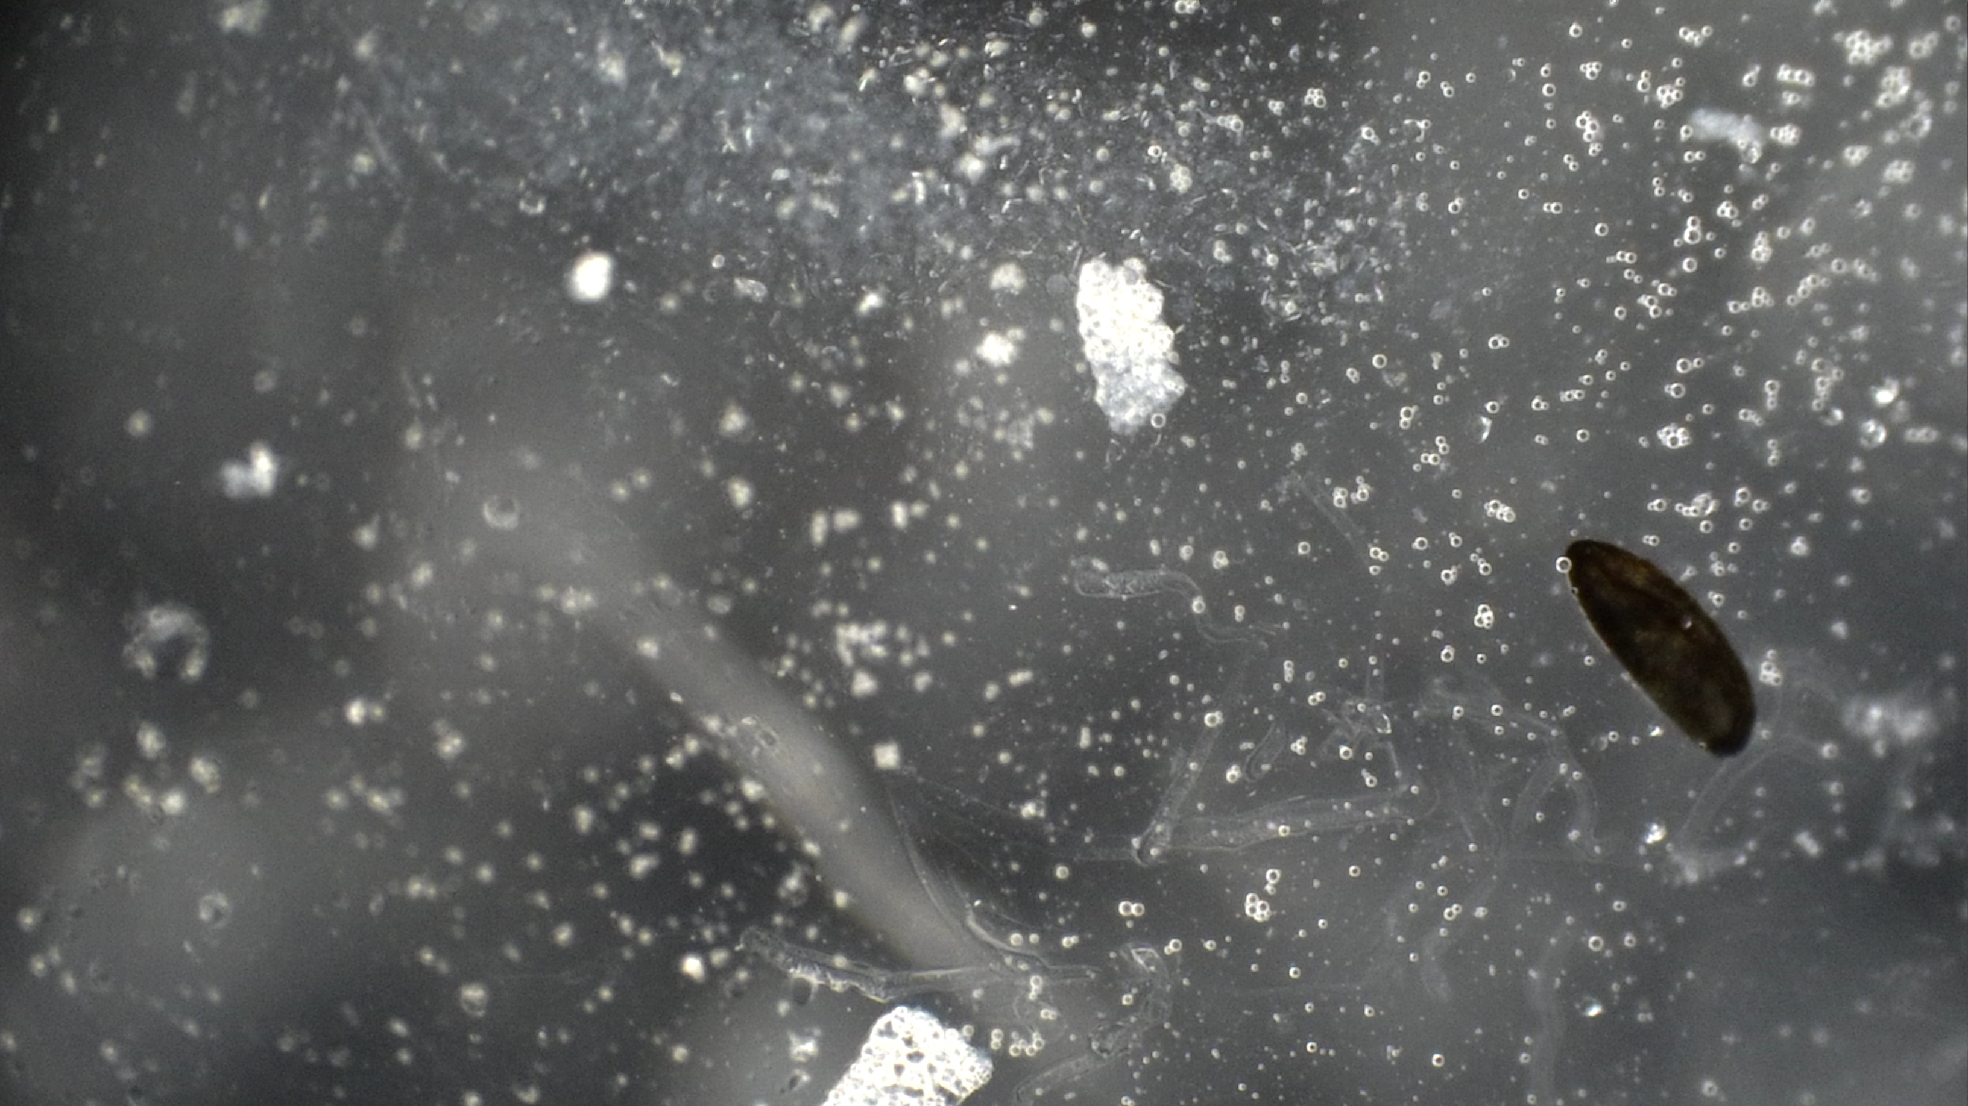
A
18h
24h
26h
892
437
B
C
Figure 4. Variation in the speed of melanization reaction between the resistant and susceptible lines. (A) The images taken at 18h, 24h and 26h after L.boulardi G486 infection of lines 437 and lines 892. (B) Proportion of oil droplets with signs of melanization at different time points post injection in the resistant and susceptible lines. Points represent means and error bars the 95% confidence interval.

Slide 5
437
Figure 5. Melanisation response at 26h vary in REC lines crossed with C3. The heterozygous F1 progeny of REC line crossed with C3 have different proportions of oil droplets melanised at 26h post injections. The red bars are lines which contain the lectin 24A gene and the blue line do not have lectin 24A. The lines C2 and 892 were both crossed to obtain a f1 progeny that were injected as controls. Approximately 40 larvae per line were dissected to check the presence of a melanised capsule and the error bars…

Slide 6
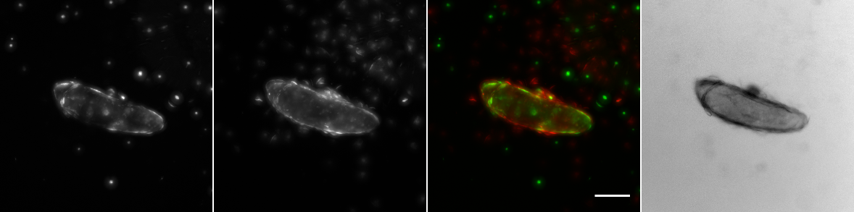
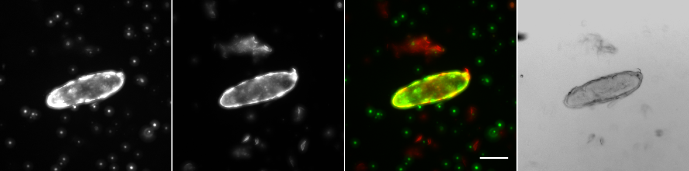
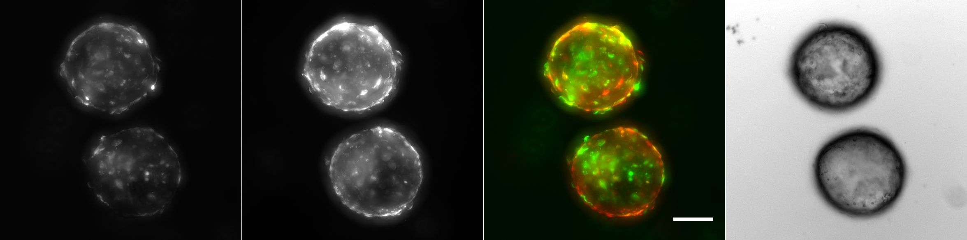
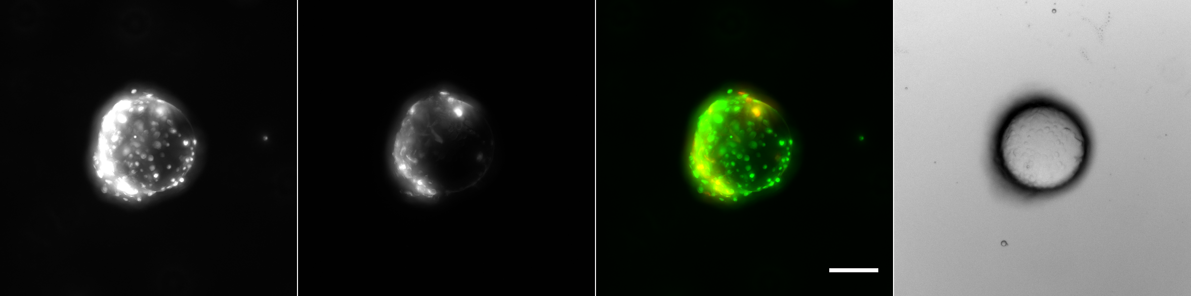
A
B
C
Hml>GFP
Msn-mCherry
Composite
Transmitted light
DGRP-437
Infection
DGRP-892
DGRP-437
Oil injection
DGRP-892
Figure 8. Cellular immune response in fluorescent stocks to parasitoid infection. (A) the proportion of melanised L.boulardi G486 embryo in the F1 progeny of Hml-GAL4 UAS GFP; Msn-mCherry stocks crossed with 437 or 892. The controls for this experiment were lines 437 and 892. Error bars show a 95% confidence interval . (B) The F1 progeny of Hml-GAL4 UAS GFP; Msn-mCherry stocks crossed with 437 or 892 were injected with oil droplets which contained L.boulardi wasp extract and were dissected 24h post injection. (C) Images taken on a , which show hemocytes attached to the injected oil droplet in the larvae dissected 24h after injection

Slide 7
24h
48h
X
2
3
I I
I I
I I
I I
I I
I I
I I
I I
I I
I I
I I
I I
I I
I I
I I
I I
I I
I I
I I
I I
I I
I I
I I
I I
I I
I I
I I
I I
I I
I I
I I
I I
I I
I I
I I
I I
437^{R}
892^{S}
Figure S1

